Slide 1
What is the Effect of Personalized Cognitive Strategy Instruction on Facilitating Return-to-Learn for Individuals Experiencing Prolonged Concussion Symptoms? Dissertation Defense
Jim Wright
Department of Communication Disorders & Sciences
Faculty Advisor and Chairperson: Dr. McKay Sohlberg
April 9, 2021

Slide 2
Overview
Study rationale
Research questions
Methods
Results
Discussion and interpretation

Slide 3
1. Study Rationale
Define concussion
Define prolonged concussion symptoms (PCS)
Summary of current treatment recommendations
Knowledge gap

Slide 4
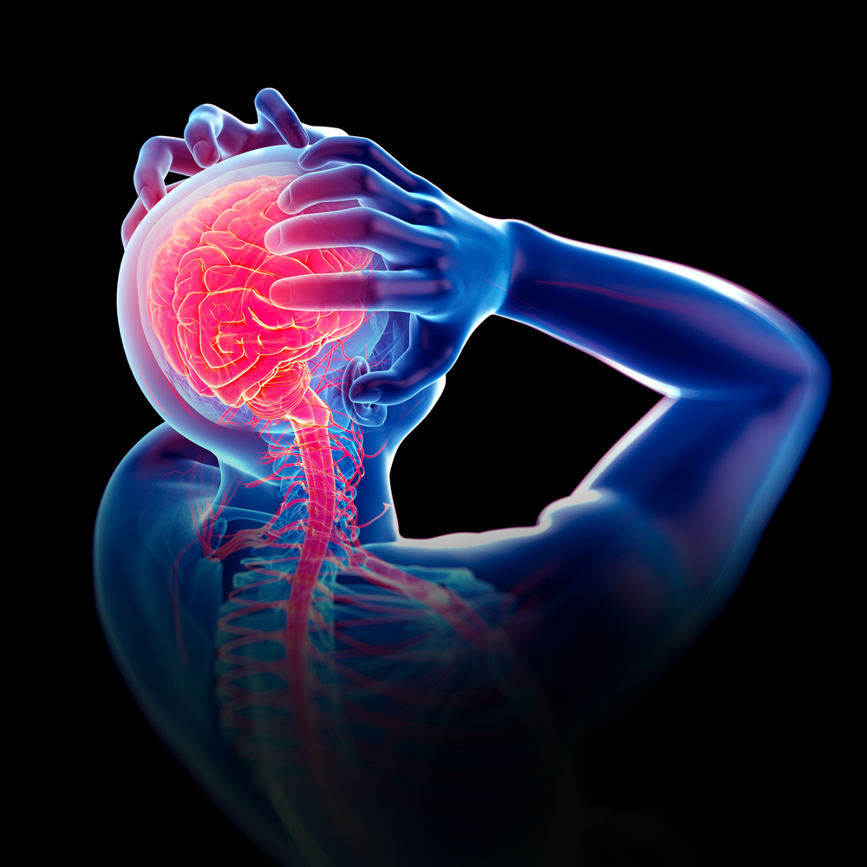
(Barkhoudarian et al., 2011; Giza & Hovda, 2014)
A. Definition:
The application of biomechanical force to the head and/or neck via linear and/or rotational acceleration that leads to observable changes in cognitive, somatic, and neurobehavioral functioning

Slide 5
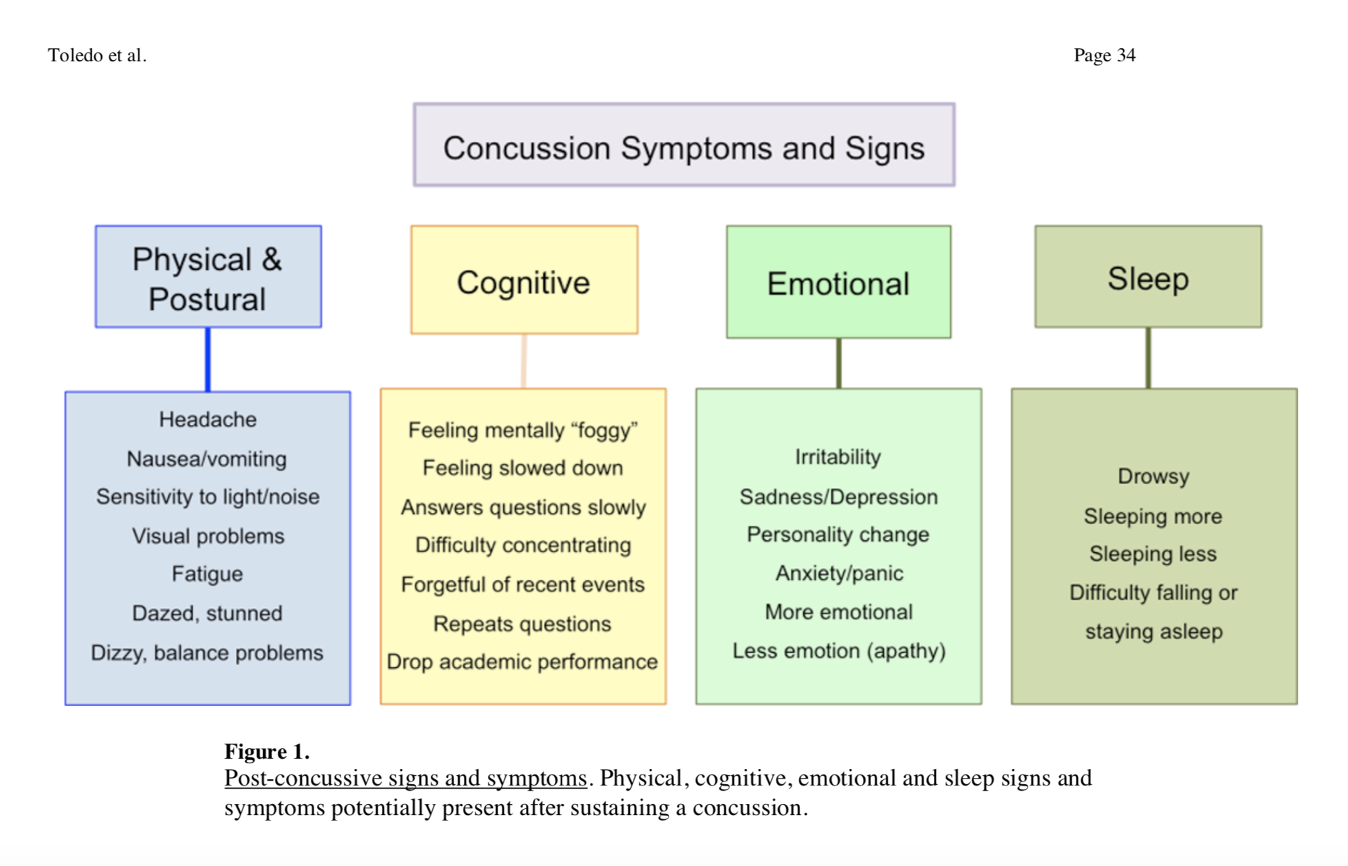
Toledo et al., (2012)

Slide 6

Symptom Clusters
More recent research suggests there are 6 symptom clusters (Lumba-Brown, 2019, Harmon, 2019)
Headache-Migraine Symptom Cluster
Cognitive Symptom Cluster
Anxiety-Mood Symptom Cluster
Ocular-Motor Symptom Cluster
Vestibular Symptom Cluster
Sleep Symptom Cluster

Slide 7
B. PCS Defined
Occurs in 10-15% of the 1.6-3.8 million annual concussion cases
General consensus between DSM-IV and ICD-10 in diagnostic criteria of PCS
Defined as the presence of three or more symptoms for at least three months following the injury
Contributing factors to PCS development:
Pre-injury risk factors
Injury-related risk factors
Post-injury risk factors
(Babcock et al., 2013; Zemek et al., 2013)

Slide 8
C. Summary of Current Treatment Recommendations
Variety of approaches to managing PCS with limited research
Historically evaluated in manualized programs
Support for multidisciplinary treatment
Interventions must account for interaction of symptom clusters
Improvements with psychoeducation and cognitive strategy instruction have been noted
(Cooper et al., 2016; Huckans et al., 2010; Sohlberg & Ledbetter, 2016; Storzbach et al., 2017; Twamley et al., 2014)

Slide 9
C. Summary of Current Treatment Recommendations
Retrospective research has influenced my approach to a personalized and dynamic treatment
Identify client needs
Match treatment components to client’s needs
Implement dynamic intervention dependent upon client progress
(Wright et al., 2020)

Slide 10
D. Knowledge Gap
Understanding of which treatment components are most faciliatory in returning students experiencing PCS to pre-injury level
Understanding of the benefit of personalizing selection of cognitive strategies to meet individual needs
The need for a protocol that can feasibly be implemented in school or clinic settings

Slide 11
2. Research Questions
Is there a functional relation between the addition of personalized cognitive strategy instruction to psychoeducation and the achievement of student RTL targets?
Do selected scores on the pre/post outcome measures that aid in the treatment selection process yield positive change following the delivery of personalized cognitive strategy instruction?

Slide 12
3. Methods
Setting and participant characteristics
Experimental design
Procedures
Measurements
Analyses

Slide 13
A. Setting and Participant Characteristics
Brain Injury and Concussion Clinic (BrICC) outpatient services
All sessions conducted via telehealth over zoom
All sessions facilitated by two graduate student clinicians
Eligibility Requirements:
Ages 13-17
Experiencing PCS
Referred to BrICC to treating ongoing cognitive challenges

Slide 14
A. Setting and Participant Characteristics
Participant | Sex | Age | Etiology | Number of Previous Concussions | History of Depression or Anxiety | Time Post Onset (months)
Participant 1 | Female | 16 | Motor vehicle accident | 0 | No | 3.5
Participant 2 | Female | 15 | Sport-related concussion | 1 | Yes | 7.5
Participant 3 | Female | 13 | Fall | 3 | Yes | 9

Slide 15
B. Experimental Design
Single case experimental design
Non-concurrent multiple-baseline design
Steps to strengthen internal validity
IV implementation staggered across participants
Randomized order of staggered IV implementation
(Byiers et al., 2012; Harvey et al., 2004; Horner et al., 2005; Kratochwill & Levin, 2010; Watson & Workman, 1981)

Slide 16
C. Procedures
Two phases
Baseline (delivery of psychoeducation)
Experimental (implementation and delivery of the IV, personalized cognitive strategy instruction)
13 total sessions per participant

Slide 17
C. Procedures – Baseline Phase
Clinical Interview
Goal Formation
Psychoeducation
Session 1
Identify participant concerns and develop goals
Session 1
Influenced by participant responses in clinical interview and BRIEF-2/CLASS
Reflect cognitive domain and academic behavior targeted
Implemented during clinical interview and every baseline session
Uniform across all participants

Slide 18
C. Procedures – Baseline Phase (Clinical Interview)
Open-ended questions
What are you concerns since the concussion?
If you could make progress in one area, what would it be?
What has changed since your concussion?
What have you tried?
Validation and self-reflection of participant statements
Facilitates the identification of priorities and goal development

Slide 19
C. Procedures – Baseline Phase (Psychoeducation)
Uniform delivery across participants
Three specific topics
Symptom expectations
Symptom duration
Symptom management
Delivered via didactic instruction with teach-back

Slide 20
C. Procedures – Experimental Phase
Personalized Cognitive Strategy Instruction
Implemented during final baseline session to begin measuring impact the following session
Purpose is to identify strategy for participant that addresses their concerns and can compensate for cognitive challenges

Slide 21
D. Measurements
Repeated Measures
Pre/Post Outcome Measures
Goal Attainment Scale (GAS)
Baseline and Intervention Phase
Status tracking
Treatment Implementation and Outcome
Treatment fidelity
Baseline Phase
Experimental Phase
Frequency of strategy use
Behavior Rating Index of Executive Function (BRIEF)
Concussion Learning Assessment and School Survey (CLASS)
Post-Concussion Symptom Scale (PCSS)
Social validity and treatment appropriateness
Treatment attendance
Perceived strategy helpfulness

Slide 22
D. Measurements - Repeated Measurements (Status Tracking)
Collected every session during both phases
Directly corresponded to participant GAS
Aligned with participant functional goal
Primary indicator of responsivity to treatment
Primary measurement analyzed to determine existence of functional relation
Hypothesized to increase with the introduction of personalized cognitive strategy instruction
(Ownsworth et al., 2000; Toglia & Kirk, 2000)

Slide 23
D. Measurements - Repeated Measurements (Frequency of Strategy Use)
Rationale:
has been measured in previous mTBI literature
Frequency identified to increase post-intervention
Present study:
Hypothesized that elevated and sustained frequency of strategy use would occur parallel to increased and sustained progress on status tracking measurement
(Huckans et al., 2010; Storzbach et al., 2017)

Slide 24
D. Measurements - Repeated Measurements (Perceived Strategy Helpfulness)
Rationale:
has been measured in previous mTBI literature
Strategies found to be more helpful in individuals with high frequency of use
Present Study:
Hypothesized that elevated and sustained strategy helpfulness would correspond with sustained improvements on status tracking measurement
Measured on a 1-5 scale:
1 = not helpful at all
2 = not helpful
3 = somewhat helpful
4 = helpful
5 = very helpful
(Huckans et al., 2010; Storzbach et al., 2017)

Slide 25
D. Measurements – Pre/Post Outcome Measurements
Goal Attainment Scale (GAS)
Behavior Rating Index of Executive Functioning* (BRIEF)
Concussion Learning Assessment and School Survey* (CLASS)
Post-Concussion Symptom Scale (PCSS)
*Administered to both participant and their parent
BRIEF, CLASS, and PCSS administered three times
Session 1 (clinical interview)
Transition from baseline phase to experimental phase
Completion of study

Slide 26
D. Measurements - Pre/Post Outcome Measurements (GAS)
Hierarchy of potential outcome with 5 discrete, equidistant levels
Best possible improvement
Better than expected improvement
Expected improvement
Baseline performance
Much less than expected performance
Aligned with participant treatment goals
Directly corresponded to status tracking measurement
Participants hypothesized to obtain and sustain expected levels of performance or greater with introduction of personalized cognitive strategy instruction
(Grant & Ponsford, 2014; Krasny-Pacini et al., 2013; Malec, 2001)

Slide 27
D. Measurements - Pre/Post Outcome Measurements (BRIEF)
Questionnaire to measure executive functioning and behavioral regulation skills
Parent and participant report
BRIEF-2: participants ages 13-17
Rationale for present study:
Identify clinically elevated scores at first administration to assist in goal formation and eventual treatment selection
Hypothesized index/scale scores that influenced treatment at first administration would obtain most positive change following delivery of personalized cognitive strategy instruction
(Gioia et al., 2000)

Slide 28
BRIEF-2
Global Composite Score
Behavioral Regulation Index
Inhibit Scale
Self-Monitor Scale
Emotional Regulation Index
Shift Scale
Emotional Control Scale
Cognitive Regulation Index
Task Completion Scale
Working Memory Scale
Plan/Organize Scale

Slide 29
D. Measurements - Pre/Post Outcome Measurements (CLASS)
20-item questionnaire assessing:
Concern for injury’s effect on school learning and performance
New or exacerbated post-concussion academic problems
Perceived impact on academic performance
Parent and participant report
Rationale for present study:
First administration – identify academic behaviors perceived to be challenging or stressful and influence treatment goal
Hypothesized that responses that influenced treatment selection at first administration would yield most positive change after delivery of personalized cognitive strategy instruction
(Ransom et al., 2015; Ransom et al., 2016)

Slide 30
CLASS
Questions 1-14 rated:
A lot worse
Somewhat worse
A little worse
Note worse

Slide 31
CLASS
Questions 15-20 rated:
Very stressful
Moderately stressful
A little stressful
Not stressful

Slide 32
D. Measurements - Pre/Post Outcome Measurements (PCSS)
22-item symptom questionnaire
Rated 0 (no symptoms) to 6 (severe symptoms)
Symptoms 18-21 represent cognitive symptom cluster
Rationale for present study:
Observe change in cognitive symptom cluster severity rating
Hypothesized cognitive symptom cluster severity ratings would decrease following the delivery of personalized cognitive strategy instruction
(Harmon et al., 2019; Kontos et al., 2012)

Slide 33
D. Measurements – Measurements of Treatment Implementation and Outcome
Treatment fidelity
Social validity and treatment appropriateness
Treatment attendance

Slide 34
D. Measurements – Measurements of Treatment Implementation and Outcome (Treatment Fidelity)
Two observers
Five fidelity checklists across both phases
Session objectives rated on ordinal 0-2 scale
0 = objective was not introduced or covered by clinicians
1 = objective was partially achieved
2 = objective was fully achieved
Acceptable treatment fidelity = rating of 75% or greater
Calculated inter-rater reliability of fidelity measurement with Cohen’s Kappa
Acceptable agreement considered if there was weighted Cohen’s Kappa of .60 or greater across sessions rated by both observers
(Cohen, 1968; Fleiss, 1973; Toglia et al., 2020)

Slide 35
D. Measurements – Measurements of Treatment Implementation and Outcome (Social Validity and Treatment Appropriateness)
Modified version of Treatment Acceptability Rating Form-Revised (TARF-R) (Reimers et al., 1992)
Seven items
Rated on 5-point Likert scale
1 = Strongly disagree
2 = Disagree
3 = Neutral
4 = Agree
5 = Strongly agree
(Reimers et al., 1992; Schwartz & Baer, 1991)

Slide 36
D. Measurements – Measurements of Treatment Implementation and Outcome (Treatment Attendance)
Measured as number of sessions per participant that required rescheduling
Participant 1 rescheduled two sessions
Participants 2 and 3 rescheduled zero sessions

Slide 37
E. Analyses
Research Question 1
Research Question 2
Visual analysis
Level
Trend
Immediacy of effect
Consistency across phases
Statistical analysis
Tau-U
Multilevel Modeling (MLM)
Descriptive analysis
Reliable Change Index (RCI)
analyze change in BRIEF-2 responses
(Hawley, 1995; Horner et al., 2005; Jacobson et al., 1999; Jacobson & Truax, 1991; Moeyaert et al., 2014; Parker et al., 2011; Shadish et al., 2008)

Slide 38
4. Results
A. Treatment goals
B. Cognitive strategies
C. RQ 1 results
Visual analysis
Tau-U
MLM
GAS outcome
Frequency of strategy use and perceived strategy helpfulness
D. RQ 2 Results
E. Treatment fidelity
F. Social validity and treatment appropriateness

Slide 39
A. Treatment Goals

Slide 40
A. Treatment Goals

Slide 41
B. Cognitive Strategies

Slide 42
C. RQ 1 Results – Visual Analysis

Slide 43
C. RQ 1 Results – Tau-U

Slide 44
C. RQ 1 Results – MLM

Slide 45
C. RQ 1 Results – GAS Outcome
All participants achieved expected level of performance
Participants 1 and 2: following IV implementation
Participant 3: preceding IV implementation

Slide 46
C. RQ 1 Results – Frequency of Strategy Use and Perceived Strategy Helpfulness
Participants 1 and 2
Participant 3
Inconsistent strategy use and perceived helpfulness of first strategy
Facilitated discussion on identification of second strategy
Second strategy boosted use and perceived helpfulness of first strategy
Results aligned with strategy use and helpfulness hypothesis
Stability of strategy use mirrored stability in status tracking measure across both phases
Strategy use appeared to not influence status tracking measurement
Sustained high helpfulness ratings

Slide 47
C. RQ 1 Results – Frequency of Strategy Use and Perceived Strategy Helpfulness

Slide 48
C. RQ 1 Results – Frequency of Strategy Use and Perceived Strategy Helpfulness

Slide 49
C. RQ 1 Results – Frequency of Strategy Use and Perceived Strategy Helpfulness

Slide 50
C. RQ 1 Results – Frequency of Strategy Use and Perceived Strategy Helpfulness

Slide 51
C. RQ 1 Results – Frequency of Strategy Use and Perceived Strategy Helpfulness

Slide 52
C. RQ 1 Results – Frequency of Strategy Use and Perceived Strategy Helpfulness

Slide 53
D. RQ 2 Results – Observed Trends to BRIEF-2, CLASS, and PCSS Responses
Participant 1
Participant 2
Participant 3
Elevated and sustained PCSS severity ratings
BRIEF-2/CLASS responses worsened
No significant RCI values comparing BRIEF-2 responses on self-report
Self/parent disparity on BRIEF-2/CLASS initial responses
Responses improved on all measures
Significant RCI values obtained comparing BRIEF-2 responses on self/parent-report
Self/parent disparity on BRIEF-2/CLASS initial responses
Responses improved on all measures
Significant RCI values obtained comparing BRIEF-2 responses on self/parent-report
Self/parent-report similarities on BRIEF-2/CLASS initial responses

Slide 54
D. RQ 2 Results – Participant 1
Scale/Index | T-Score Value |  |  | RCI Value
 | Pre-Baseline Phase | Pre-Experimental Phase | Post-Experimental Phase | Pre-Baseline/ Pre-Experimental | Pre-Experimental/ Post-Experimental
Task Completion Scale | 69* | 75* | 86* | 0.99 | 1.81
Working Memory Scale | 78* | 78* | 82* | 0 | 0.80
Plan/Organize Scale | 60 | 66* | 63 | 1.25 | -0.63
Cognitive Regulation Index | 70* | 74* | 78* | 0.97 | 0.97
BRIEF-2 Self-Report

Slide 55
D. RQ 2 Results – Participant 1
Scale/Index | T-Score Value |  |  | RCI Value
 | Pre-Baseline Phase | Pre-Experimental Phase | Post-Experimental Phase | Pre-Baseline/ Pre-Experimental | Pre-Experimental/ Post-Experimental
Task-Monitor Scale | 49 | 49 | 44 | 0 | -1.00
Working Memory Scale | 62 | 56 | 67 | -2.41** | 4.42**
Plan/Organize Scale | 48 | 51 | 53 | 0.74 | 0.49
Cognitive Regulation Index | 53 | 50 | 58 | -1.05 | 2.81**
BRIEF-2 Parent-Report

Slide 56
D. RQ 2 Results – Participant 1
Item | Self-Report Responses |  |  | Parent-Report Responses
 | Pre-Baseline Phase | Pre-Experimental Phase | Post-Experimental Phase | Pre-Baseline Phase | Pre-Experimental Phase | Post-Experimental Phase
Trouble Remembering What Was Studied | A Lot Worse | A Lot Worse | A Lot Worse | A Lot Worse | Somewhat Worse | A Lot Worse
Headaches interfering With Classwork | A Lot Worse | Somewhat Worse | A Lot Worse | A Lot Worse | Somewhat Worse | A Lot Worse
Tiring Easily During The School Day | A Lot Worse | A Lot Worse | Somewhat Worse | Somewhat Worse | Somewhat Worse | A Lot Worse
Stressed Out About Your Grades Dropping | Very Stressful | Very Stressful | Very Stressful | Moderately Stressful | Moderately Stressful | Moderately Stressful
CLASS

Slide 57
D. RQ 2 Results – Participant 1
Item | Pre-Baseline Phase | Pre-Experimental Phase | Post-Experimental Phase
Feeling Slow | 6 | 3 | 6
Feeling Foggy | 3 | 6 | 5
Difficulty Concentrating | 2 | 4 | 3
Difficulty Remembering | 5 | 6 | 6
Cognitive Symptom Cluster Score | 16 | 19 | 20
Total Symptom Severity Score | 71 | 76 | 77
PCSS

Slide 58
D. RQ 2 Results – Participant 2
Scale/Index | T-Score Value |  |  | RCI Value
 | Pre-Baseline Phase | Pre-Experimental Phase | Post-Experimental Phase | Pre-Baseline/ Pre-Experimental | Pre-Experimental/ Post-Experimental
Task Completion Scale | 86* | 82* | 72* | -0.66 | -1.64
Working Memory Scale | 82* | 78* | 65* | -0.80 | -2.61**
Plan/Organize Scale | 71* | 63 | 50 | -1.67 | -2.72**
Cognitive Regulation Index | 81* | 75* | 62 | -1.46 | -3.16**
BRIEF-2 Self-Report

Slide 59
D. RQ 2 Results – Participant 2
Scale/Index | T-Score Value |  |  | RCI Value
 | Pre-Baseline Phase | Pre-Experimental Phase | Post-Experimental Phase | Pre-Baseline/ Pre-Experimental | Pre-Experimental/ Post-Experimental
Task-Monitor Scale | 57 | 57 | 49 | 0 | -1.60
Working Memory Scale | 59 | 62 | 53 | 1.21 | -3.62**
Plan/Organize Scale | 58 | 53 | 53 | -1.23 | 0
Cognitive Regulation Index | 60 | 56 | 51 | -1.40 | -1.76
BRIEF-2 Parent-Report

Slide 60
D. RQ 2 Results – Participant 2
Item | Self-Report Responses |  |  | Parent-Report Responses
 | Pre-Baseline Phase | Pre-Experimental Phase | Post-Experimental Phase | Pre-Baseline Phase | Pre-Experimental Phase | Post-Experimental Phase
Difficulty Understanding New Material | A Lot Worse | Somewhat Worse | A Little Worse | A Little Worse | Not Worse | Not Worse
Difficulty Studying For Tests or Quizzes | A Lot Worse | Somewhat Worse | A Little Worse | A Little Worse | Not Worse | Not Worse
Trouble Remembering What Was Studied | A Lot Worse | A Lot Worse | A Little Worse | Somewhat Worse | Not Worse | Not Worse
Trouble Remembering What | Very Stressful | Very Stressful | Moderately Stressful | A Little Stressful | Moderately Stressful | Moderately Stressful
CLASS

Slide 61
D. RQ 2 Results – Participant 2
Item | Pre-Baseline Phase | Pre-Experimental Phase | Post-Experimental Phase
Feeling Slow | 1 | 2 | 0
Feeling Foggy | 1 | 0 | 0
Difficulty Concentrating | 3 | 5 | 2
Difficulty Remembering | 4 | 5 | 3
Cognitive Symptom Cluster Score | 9 | 12 | 5
Total Symptom Severity Score | 27 | 41 | 15
PCSS

Slide 62
D. RQ 2 Results – Participant 3
Scale/Index | T-Score Value |  |  | RCI Value
 | Pre-Baseline Phase | Pre-Experimental Phase | Post-Experimental Phase | Pre-Baseline/ Pre-Experimental | Pre-Experimental/ Post-Experimental
Task Completion Scale | 78* | 82* | 64 | 0.66 | -2.96**
Working Memory Scale | 72* | 84* | 63 | 2.41** | -4.22**
Plan/Organize Scale | 60 | 73* | 60 | 2.72** | -2.72**
Cognitive Regulation Index | 71* | 82* | 63 | 2.67** | -4.61**
BRIEF-2 Self-Report

Slide 63
D. RQ 2 Results – Participant 3
Scale/Index | T-Score Value |  |  | RCI Value
 | Pre-Baseline Phase | Pre-Experimental Phase | Post-Experimental Phase | Pre-Baseline/ Pre-Experimental | Pre-Experimental/ Post-Experimental
Task-Monitor Scale | 47 | 61 | 47 | 2.81** | -2.81**
Working Memory Scale | 72* | 70* | 59 | -0.80 | -4.42**
Plan/Organize Scale | 71* | 58 | 53 | -3.19** | -1.23
Cognitive Regulation Index | 66* | 64 | 54 | -0.70 | -3.51**
BRIEF-2 Parent-Report

Slide 64
D. RQ 2 Results – Participant 3
Item | Self-Report Responses |  |  | Parent-Report Responses
 | Pre-Baseline Phase | Pre-Experimental Phase | Post-Experimental Phase | Pre-Baseline Phase | Pre-Experimental Phase | Post-Experimental Phase
In Class, Work Taking Longer | Somewhat Worse | Somewhat Worse | Somewhat Worse | Somewhat Worse | A Little Worse | Not Worse
Homework Taking Longer | Somewhat Worse | Somewhat Worse | A Lot Worse | A Lot Worse | A Little Worse | Not Worse
Difficulty Studying For Tests or Quizzes | Somewhat Worse | A Lot Worse | A Little Worse | A Lot Worse | A Little Worse | A Little Worse
Trouble Remembering What Was Studied | A Little Worse | A Little Worse | A Little Worse | A Lot Worse | A Lot Worse | Not Worse
CLASS

Slide 65
D. RQ 2 Results – Participant 3
Item | Self-Report Responses |  |  | Parent-Report Responses
 | Pre-Baseline Phase | Pre-Experimental Phase | Post-Experimental Phase | Pre-Baseline Phase | Pre-Experimental Phase | Post-Experimental Phase
Easily Distracted During Classwork | A Lot Worse | A Lot Worse | Somewhat Worse | A Little Worse | Somewhat Worse | Not Worse
Easily Distracted During Homework | Somewhat Worse | Somewhat Worse | A Little Worse | A Little Worse | Somewhat Worse | A Little Worse
Headaches Interfering With Classwork | A Lot Worse | Somewhat Worse | A Little Worse | Somewhat Worse | A Little Worse | Not Worse
Headaches Interfering With Homework | A Lot Worse | Somewhat Worse | A Little Worse | Somewhat Worse | A Little Worse | Not Worse
Stressed Out About Your Grades Dropping | Moderately Stressful | Moderately Stressful | A Little Stressful | Not Stressful | A Little Stressful | Not Stressful
CLASS

Slide 66
D. RQ 2 Results – Participant 3
Item | Pre-Baseline Phase | Pre-Experimental Phase | Post-Experimental Phase
Feeling Slow | 5 | 1 | 1
Feeling Foggy | 4 | 1 | 0
Difficulty Concentrating | 5 | 4 | 3
Difficulty Remembering | 4 | 2 | 1
Cognitive Symptom Cluster Score | 18 | 8 | 5
Total Symptom Severity Score | 73 | 27 | 32
PCSS

Slide 67
E. Treatment Fidelity
Observer | Fidelity Rating
1 | 95.99%
2 | 80.56%

Slide 68
F. Social Validity and Treatment Appropriateness

Slide 69
5. Discussion and Interpretation
Profiles of clinical response
Measurements
Study limitations
Summary and clinical implications

Slide 70
A. Profiles of Clinical Response
Two of three participants responded to intervention
All participants achieved and maintained expected performance on GAS hierarchy
Responses to TARF-R suggest all participants endorsed treatment
Profiles emerged for each participant

Slide 71
A. Profiles of Clinical Response
Participant 1
Participant 2
Outcome aligned with RQ 1 and 2
Outcome aligned with RQ 1 only
Participant 3
Outcome aligned with RQ 2 only
Responded to collaborative goal development and status tracking measurement
Trajectory of BRIEF-2/CLASS/PCSS responses suggest complex recovery
Responsive to all components of intervention
Demonstrated ability to generalize strategy use to other courses
Implementation of personalized strategy did not facilitate functional change
Apparent accountability of status tracking measurement
Influence of her age

Slide 72
B. Measurements
Facilitated dynamic intervention
Baseline measurements dictated treatment development
Ongoing measurement of participant performance dictated service delivery in the experimental phase
Development of GAS hierarchy paired with ongoing status tracking most important

Slide 73
B. Measurements
Repeated Measurements
Pre/Post Outcome Measurements
First administrations of BRIEF-2/CLASS critical to identifying need and establishing goals
Facilitated client-participant discussion and reflection on participant performance
Most useful for Participants 1 and 2
Support the use of dynamic approach to treat PCS
Response pattens to BRIEF-2/CLASS/PCSS moved in tandem
Three administrations was tedious for participants
Participant 1 and 2 self/parent response discrepancies

Slide 74
C. Study Limitations
Contextual factors
Methodological factors
COVID-19 history effect
Forced sessions to occur via telehealth
Participant remote learning fatigue
Influenced Participant 1 treatment goal
Small sample size
Limited data points for Participant 2 baseline phase
Use of self-report measurement

Slide 75
D. Summary and Clinical Implications
Empirical and dynamic approach to treatment can be successful
Benefit of GAS
Positive response to treatment (TARF-R) results
Intervention may be better evaluated through a group design (ITS)

Slide 76
References
Babcock, L., Byczkowski, T., Wade, S. L., Ho, M., Mookerjee, S., & Bazarian, J. J. (2013). Predicting postconcussion syndrome after mild traumatic brain injury in children and adolescents who present to the emergency department. JAMA Pediatrics, 167(2), 156–161. https://doi.org/10.1001/jamapediatrics.2013.434
Barkhoudarian, G., Hovda, D. A., & Giza, C. C. (2011). The molecular pathophysiology of concussive brain injury. Clinics in Sports Medicine, 30(1), 33–48.
Byiers, B. J., Reichle, J., & Symons, F. J. (2012). Single-subject experimental design for evidence-based practice. 21, 397–414. https://doi.org/10.1044/1058-0360(2012/11-0036)The
Cohen, J. (1968). Weighted kappa: Nominal scale agreement provision for scaled disagreement or partial credit. Psychological Bulletin, 70(4), 213–220. https://doi.org/10.1037/h0026256
Cooper, D. B., Bowles, A. O., Kennedy, J. E., Curtiss, G., French, L. M., Tate, D. F., & Vanderploeg, R. D. (2016). Cognitive rehabilitation for military service members with mild traumatic brain injury: A randomized clinical trial. Journal of Head Trauma Rehabilitation, 32(3), E1–E15. https://doi.org/10.1097/HTR.0000000000000254
Fleiss, J. L. (1973). The equivalence of weighted Kappa and the Intraclass Correlation Coefficient as measures of reliability. Educational and Psychological Measurement, 33(3), 613–619.
Gioia, G. A., Isquith, P. K., Guy, S. C., & Kenworthy, L. (2000). Behavior rating inventory of executive function. Child Neuropsychology, 6(3), 235–238. https://doi.org/10.1076/chin.6.3.235.3152
Giza, C. C., & Hovda, D. A. (2014). The new neurometabloic cascade of concussion. Neurosurgery, 75(4), 24–33. https://doi.org/10.1227/NEU.0000000000000505.The
Grant, M., & Ponsford, J. (2014). Goal attainment scaling in brain injury rehabilitation: Strengths, limitations and recommendations for future applications. Neuropsychological Rehabilitation, 24(5), 661–667. https://doi.org/10.1080/09602011.2014.901228
Harmon, K. G., Clugston, J. R., Dec, K., Hainline, B., Herring, S., Kane, S. F., Kontos, A. P., Leddy, J. J., McCrea, M., Poddar, S. K., Putukian, M., Wilson, J. C., & Roberts, W. O. (2019). American Medical Society for Sports Medicine position statement on concussion in sport. British Journal of Sports Medicine, 53(4), 213–225. https://doi.org/10.1136/bjsports-2018-100338
Harvey, M. T., May, M. E., & Kennedy, C. H. (2004). Nonconcurrent multiple baseline designs and the evaluation of educational systems. Journal of Behavioral Education, 13(4), 267–276. https://doi.org/10.1023/b:jobe.0000044735.51022.5d
Hawley, D. R. (1995). Assessing change with preventive interventions : The reliable change index. 44(3), 278–284.
Horner, R. H., Carr, E. G., Halle, J., Mcgee, G., Odom, S., & Wolery, M. (2005). The use of single-subject research to identify evidence-based practice in special education. Exceptional Children, 71(2), 165–179. https://doi.org/10.1177/001440290507100203
Huckans, M., Pavawalla, S., Demadura, T., Kolessar, M., Seelye, A., Roost, N., Twamley, E. W., & Storzbach, D. (2010). A pilot study examining effects of group-based cognitive strategy training treatment on self-reported cognitive problems, psychiatric symptoms, functioning, and compensatory strategy use in OIF/OEF combat veterans with persistent mild cognitive disorder a. Journal of Rehabilitation Research and Development, 47(1), 43–60. https://doi.org/10.1682/JRRD.2009.02.0019
Jacobson, N. S., Roberts, L. J., Berns, S. B., & McGlinchey, J. B. (1999). Methods for defining and determining the clinical significance of treatment effects: Description, application, and alternatives. Journal of Consulting and Clinical Psychology, 67(3), 300–307. https://doi.org/10.1037/0022-006X.67.3.300

Slide 77
References
Jacobson, N. S., & Truax, P. (1991). Clinical significance: A statistical approach to defining meaningful change in psychotherapy research. Journal of Consulting and Clinical Psychology, 59(1), 12–19. https://doi.org/10.1037/0022-006X.59.1.12
Kontos, A. P., Elbin, R. J., Schatz, P., Covassin, T., Henry, L., Pardini, J., & Collins, M. W. (2012). A revised factor structure for the post-concussion symptom scale: Baseline and postconcussion factors. American Journal of Sports Medicine, 40(10), 2375–2384. https://doi.org/10.1177/0363546512455400
Krasny-Pacini, A., Hiebel, J., Pauly, F., Godon, S., & Chevignard, M. (2013). Goal Attainment Scaling in rehabilitation: A literature-based update. Annals of Physical and Rehabilitation Medicine, 56(3), 212–230. https://doi.org/10.1016/j.rehab.2013.02.002
Kratochwill, T. R., & Levin, J. R. (2010). Enhancing the scientific credibility of single-case intervention research: Randomization to the rescue. Psychological Methods, 15(2), 124–144. https://doi.org/10.1037/a0017736
Malec, J. F. (2001). Impact of comprehensive day treatment on societal participation for persons with acquired brain injury. Archives of Physical Medicine and Rehabilitation, 82(7), 885–895. https://doi.org/10.1053/apmr.2001.23895
McNally, K. A., Patrick, K. E., LaFleur, J. E., Dykstra, J. B., Monahan, K., & Hoskinson, K. R. (2018). Brief cognitive behavioral intervention for children and adolescents with persistent post-concussive symptoms: A pilot study. Child Neuropsychology, 24(3), 396–412. https://doi.org/10.1080/09297049.2017.1280143
Moeyaert, M., Ugille, M., Ferron, J. M., Onghena, P., Heyvaert, M., Natasha Beretvas, S., & Van den Noortgate, W. (2014). Estimating intervention effects across different types of single-subject experimental designs: Empirical illustration. School Psychology Quarterly, 30(1), 50–63. https://doi.org/10.1037/spq0000068
Ownsworth, T. L., McFarland, K., & Young, R. M. D. (2000). Self-awareness and psychosocial functioning following acquired brain injury: An evaluation of a group support programme. Neuropsychological Rehabilitation, 10(5), 465–484. https://doi.org/10.1080/09602010050143559
Parker, R. I., Vannest, K. J., Davis, J. L., & Sauber, S. B. (2011). Combining nonoverlap and trend for single-case research: Tau-U. Behavior Therapy, 42(2), 284–299. https://doi.org/10.1016/j.beth.2010.08.006
Ponsford, J., Willmott, C., Rothwell, A., Cameron, P., Ayton, G., Nelms, R., Curran, C., & Ng, K. (2001). Impact of early intervention on outcome after mild traumatic brain injury in children. Pediatrics, 108(6), 1297–1303. https://doi.org/10.1542/peds.108.6.1297
Ransom, D. M., Vaughan, C. G., Pratson, L., Sady, M. D., McGill, C. A., & Gioia, G. A. (2015). Academic effects of concussion in children and adolescents. Pediatrics, 135(6), 1043–1050. https://doi.org/10.1542/peds.2014-3434
Ransom, Danielle M., Burns, A. R., Youngstrom, E. A., Vaughan, C. G., Sady, M. D., & Gioia, G. A. (2016). Applying an evidence-based assessment model to identify students at risk for perceived academic problems following concussion. Journal of the International Neuropsychological Society, 22(10), 1038–1049. https://doi.org/10.1017/S1355617716000916
Reimers, T. M., Wacker, D. P., Cooper, L. J., & Deraad, A. O. (1992). Clinical evaluation of the variables associated with treatment acceptability and their relation to compliance. Behavioral Disorders, 18(1), 67–76. https://doi.org/10.1177/019874299201800108

Slide 78
References
Scheenen, M. E., Visser-Keizer, A. C., Van Der Naalt, J., & Spikman, J. M. (2017). Description of an early cognitive behavioral intervention (UPFRONT-intervention) following mild traumatic brain injury to prevent persistent complaints and facilitate return to work. Clinical Rehabilitation, 31(8), 1019–1029. https://doi.org/10.1177/0269215516687101
Schwartz, I. S., & Baer, D. M. (1991). Social validity assessments: Is current practice state of the art? Journal of Applied Behavior Analysis, 24(2), 189–204. https://doi.org/10.1901/jaba.1991.24-189
Shadish, W. R., Rindskopf, D. M., & Hedges, L. V. (2008). The state of the science in the meta-analysis of single-case experimental designs. Evidence-Based Communication Assessment and Intervention, 2(3), 188–196. https://doi.org/10.1080/17489530802581603
Sohlberg, M. M., & Ledbetter, A. K. (2016). Management of persistent cognitive symptoms after sport-related concussion. American Journal of Speech-Language Pathology, 25, 138–149.
Storzbach, D., Twamley, E. W., Roost, M. S., Golshan, S., Williams, R. M., O Neil, M., Jak, A. J., Turner, A. P., Kowalski, H. M., Pagulayan, K. F., & Huckans, M. (2017). Compensatory cognitive training for Operation Enduring Freedom/Operation iraqi Freedom/Operation New Dawn veterans with mild traumatic brain injury. Journal of Head Trauma Rehabilitation, 32(1), 16–24. https://doi.org/10.1097/HTR.0000000000000228
Toglia, J., & Kirk, U. (2000). Understanding awareness deficits following brain injury. NeuroRehabilitation, 15(1), 57–70. https://doi.org/10.3233/nre-2000-15104
Toglia, Joan, Lee, A., Steinberg, C., & Waldman-Levi, A. (2020). Establishing and measuring treatment fidelity of a complex cognitive rehabilitation intervention: The multicontext approach. British Journal of Occupational Therapy, 83(6), 363–374. https://doi.org/10.1177/0308022619898091
Twamley, E. W., Jak, A. J., Delis, D. C., Bondi, M. W., & Lohr, J. B. (2014). Cognitive Symptom Management and Rehabilitation Therapy (CogSMART) for veterans with traumatic brain injury: Pilot randomized controlled trial. Journal of Rehabilitation Research and Development, 51(1), 59–70. https://doi.org/10.1682/JRRD.2013.01.0020
Watson, P. J., & Workman, E. A. (1981). The non-concurrent multiple baseline across-individuals design: An extension of the traditional multiple baseline design. Journal of Behavior Therapy and Experimental Psychiatry, 12(3), 257–259. https://doi.org/10.1016/0005-7916(81)90055-0
Wright, J., Sohlberg, M. M., Watson-Stites, R., & McCart, M. (2020). Identification of key therapy ingredients for SLPs serving on multidisciplinary teams facilitating return to learn for students with prolonged cognitive effects after concussion: A retrospective case series analysis. Topics in Language Disorders, 40(1), 6–35. https://doi.org/10.1097/TLD.0000000000000198
Zemek, R. L., Farion, K. J., Sampson, M., & McGahern, C. (2013). Prognosticators of persistent symptoms following pediatric concussion: A systematic review. JAMA Pediatrics, 167(3), 259–265. https://doi.org/10.1001/2013.jamapediatrics.216

Slide 79
Acknowledgements
Michelle and Fiona
Chicago family
Faculty advisor
McKay
Committee members
Kent McIntosh
John Seeley
Wendy Hadley
CDS faculty and staff
Current doc students
Heidi
Lidia
Aaron
Ting-fen
Bedoor
David
Previous doc students
Priya
Alex

